Slide 1
Arrays and Lists

Slide 2
Value Types and Reference Types
The data types in
and .NET fall into two categories: values types and reference types
A variable that is used to hold a value, such as 23, 15.87, "Hello", etc. is a value type of variable
They actually hold data
A variable that is used to reference an object is commonly called a reference variable
Reference variables can be used only to reference objects. They do not hold data.

Slide 3
How a Value Type Works
When you declare a value type variable, the compiler allocates a chunk of memory that is big enough for the variable
The memory that is allocated for a value type variable is the actual location that will hold the value assigned to the variable
When you are working with a value type, you are using a variable that holds a piece of data

Slide 4
How a Reference Type Works (1 of 2)
When you work with a reference type, you use two things:
An object that is created in memory
A variable that references the object
The object that is created in memory holds data. You need a way to refer to it.
A variable is then created to hold a value, called reference
A reference variable does not hold an actual piece of data, it simply refers to the data

Slide 5
How a Reference Type Works (2 of 2)
A reference type links the variable that holds actual data to the object
If a kite is the object, then the spool of string that holds the kite is the reference

Slide 6
Creating a Reference Type (1 of 2)
Two steps are typically required:
Declare a reference variable
Create an object and associate it with the reference variable
An example is the Random class
Random rand = new Random();
The Random rand part declares a variable named rand which will be of the Random class

Slide 7
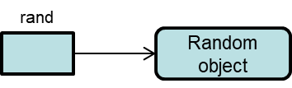
Creating a Reference Type (2 of 2)
The new Random() part creates an object and returns a reference to the object
The = operator assigns the reference that was returned from the new operator to the rand variable

Slide 8
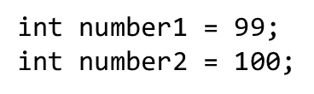
Array Basics (1 of 7)
An array allows you to store a group of items of the same data type together in memory
Processing a large number of items in an array is usually easier than processing a large number of items stored in separate variables
This is because each variable can only hold one piece of data:

Slide 9
Array Basics (2 of 7)
Each variable is a separate item that must be declared and individually processed
Variables are not ideal for storing and processing lists of data

Slide 10

Array Basics (3 of 7)
Arrays are reference type objects
To create an array, you need to:
declare a reference type object
create the object and associate it with the reference variable
In C#, the generic format to declare a reference variable for an array is:

Slide 11



Array Basics (4 of 7)
For example,
The generic format to create the array object and associate it with the variable is:
The new keyword creates an object in memory; it also returns a reference to that array. For example,

Slide 12
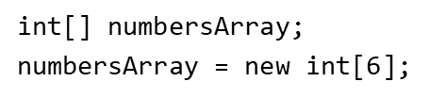

Array Basics (5 of 7)
In the previous example, there are two statements:
These two statements can be combined into one statement:

Slide 13
Array Basics (6 of 7)
If you are declaring an array inside a method, you can use the var keyword to further simplify the declaration:
var numbersArray = new int[6];

Slide 14
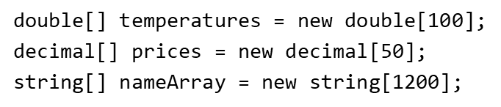
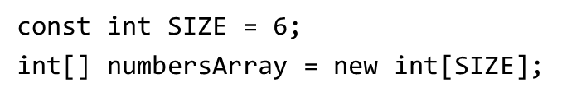
Array Basics (7 of 7)
You can create arrays of any data type
An array’s size declarator must be a positive integer and can be a literal value
It is a preferred practice to used a named constant as size declarator

Slide 15
Array Elements (1 of 2)
The storage locations in an array are known as elements
In memory, an array’s elements are located in consecutive memory locations
Each element in an array is assigned a unique number known as a subscript
Subscripts are used to identify specific elements in an array Subscripts start with 0. The first element has subscript 0, the nth element has n-1.

Slide 16
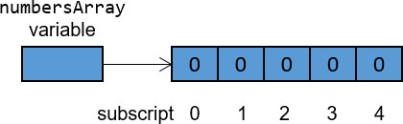
Array Elements (2 of 2)
When you create a numeric array in
its elements are set to the value of 0 by default

Slide 17
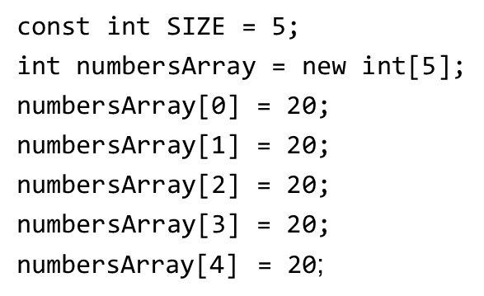

Working with Array Elements
Given the following code, you can access each individual element by using its subscript
To get the value of the 3rd element, for example, use:

Slide 18
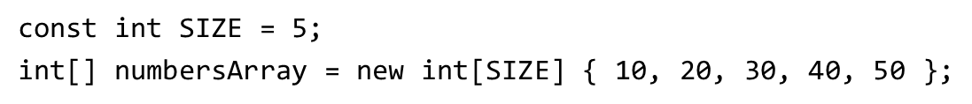
Array Initialization
When you create an array, you can optionally initialize it with a group of values
Or simply,
And even,
All three produce the same results

Slide 19
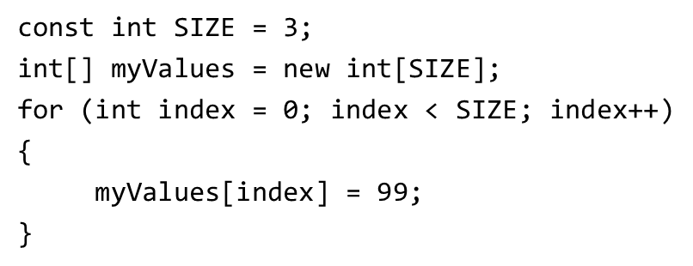
Using a Loop to Step through An Array
Arrays commonly use int as subscript. You can then create a loop to step through the array. For example,
This example assigns 99 to each element as value
Notice that the number of iterations cannot exceed the array size; otherwise, an exception will be thrown at runtime. The example below will cause an exception because SIZE = 3.

Slide 20
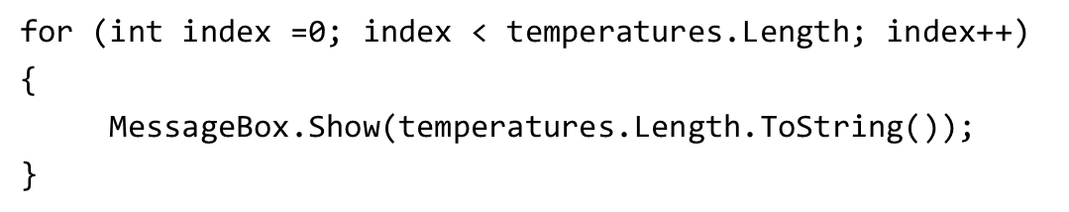
The Length Property
In
all arrays have a Length property that is set to the number of elements in the array
The output of the following is 25
The Length property can be useful when processing the entire array

Slide 21
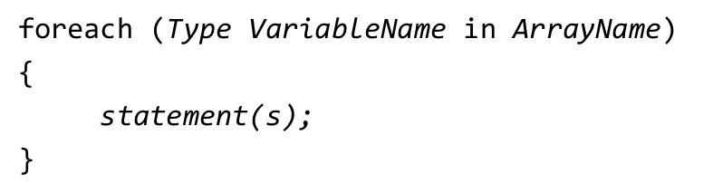
Using the foreach Loop with Arrays (1 of 2)
provides a special loop called foreach to simplify array processing
The foreach loop is designed to work a temporary, read-only variable known as an iteration variable. A generic format is:
This

Slide 22
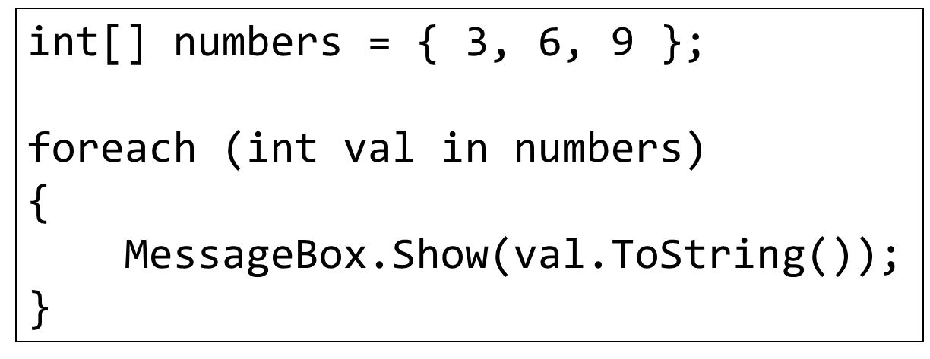
Using the foreach Loop with Arrays (2 of 2)
Type is the data type of the array
VariableName is the name of the temporary iteration variable
in is a keyword that must appear
ArrayName is the name of array to process

Slide 23
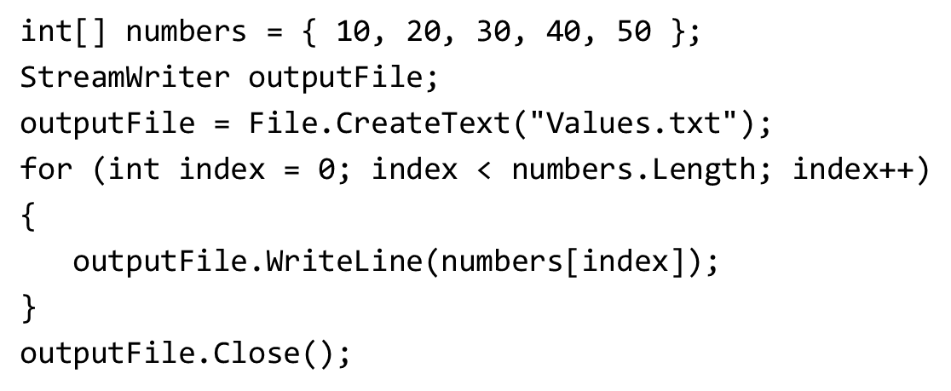
Working with Files and Array
The book demonstrates how to write an array’s contents to a file. Here is the code:

Slide 24
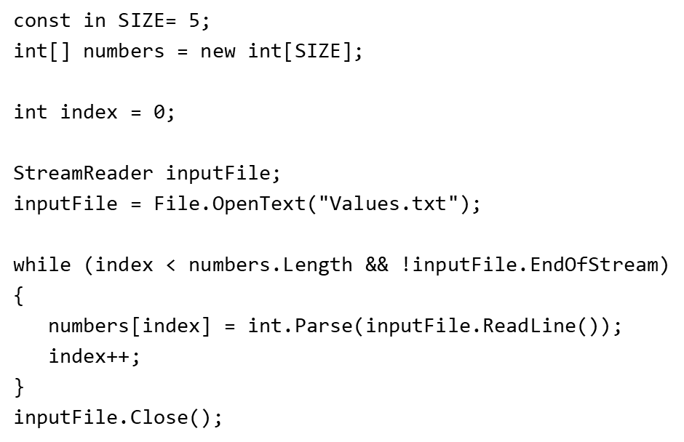
Reading Values from a File to An Array
The book demonstrates how to read values from a file and store them in an array. Here is the code:

Slide 25
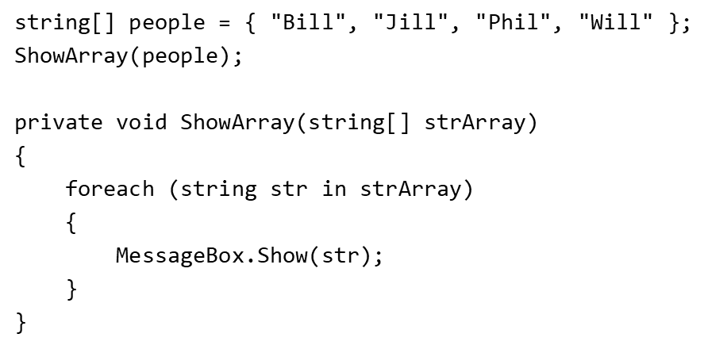
Passing Array as Argument to Methods (1 of 2)
An entire array can be passed as one argument to a method

Slide 26
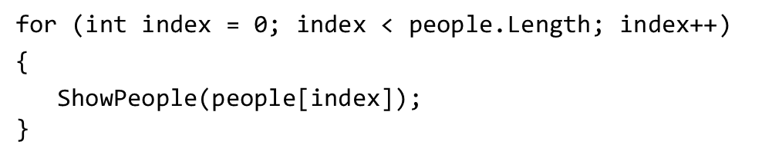
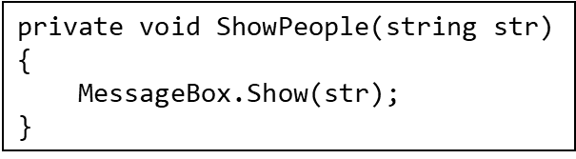
Passing Array as Argument to Methods (2 of 2)
It can also be passed individually

Slide 27
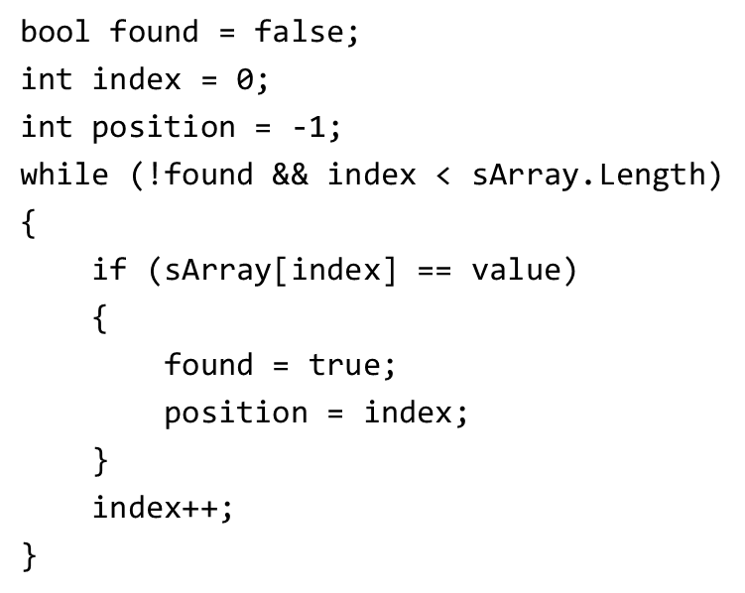
Some Useful Array Algorithms (1 of 2)
The sequential search uses a loop to sequential step through an array, starting with the first element. For example,

Slide 28
Some Useful Array Algorithms (2 of 2)
This code searches a string array for a special value. If the value is found its position is return; otherwise -1 is returned.
This algorithm is not efficient

Slide 29
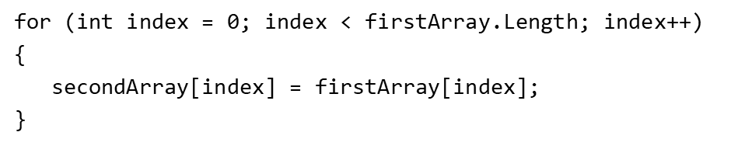
Useful Array Algorithms (1 of 2)
Copying an array – create a second array and copy the individual element of the source array to the target array
Comparing Arrays – You must compare each element of the arrays

Slide 30
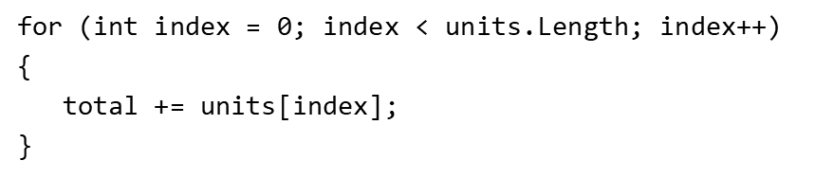

Useful Array Algorithms (2 of 2)
Totaling the value of an array – Use a loop with an accumulator variable
To find the average, use:

Slide 31
Finding the Highest Value in An Array (1 of 3)
Create a variable to hold the found highest value
Start with assuming the element 0 is the highest
Use a loop to step through element 1 and the rest
Each time the loop iterates, it compares an array element to the variable holding the found highest value. If the array element is greater than the found highest value, assign the value of that array element to the variable holding the found highest value.
When the loop finished, the highest value is found

Slide 32
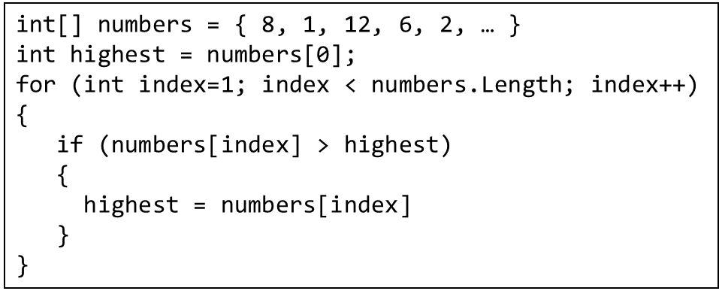
Finding the Highest Value in An Array (2 of 3)

Slide 33
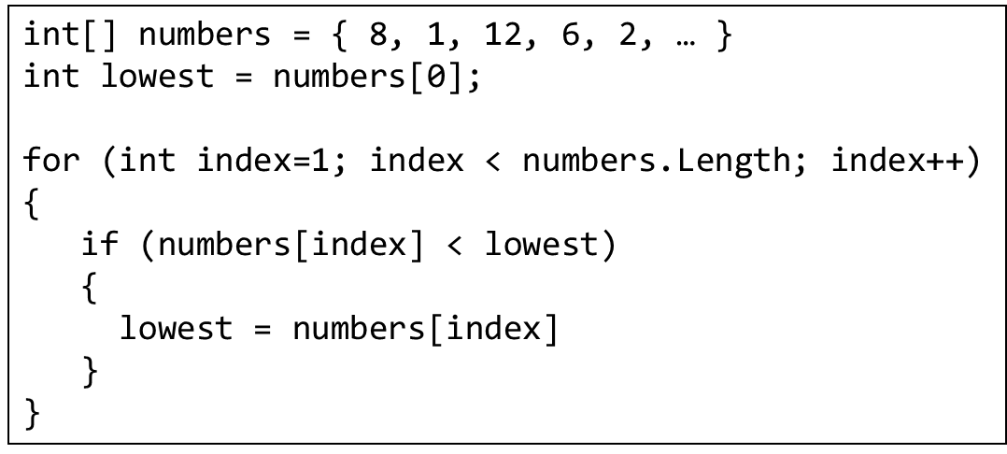
Finding the Highest Value in An Array (3 of 3)
Similarly, the lowest can be found

Slide 34
Advanced Algorithms for Sorting and Searching (1 of 3)
The selection sort works by:
locating the smallest value and moving it to element 0
Then find the second smallest and move it to element 1
Continue the process until all the elements have been placed in their proper order

Slide 35
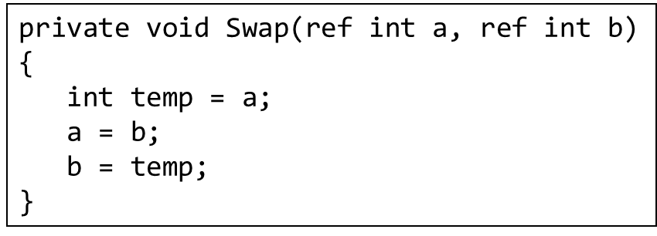
Advanced Algorithms for Sorting and Searching (2 of 3)
This algorithm requires swapping of array elements which can be done by the following:

Slide 36
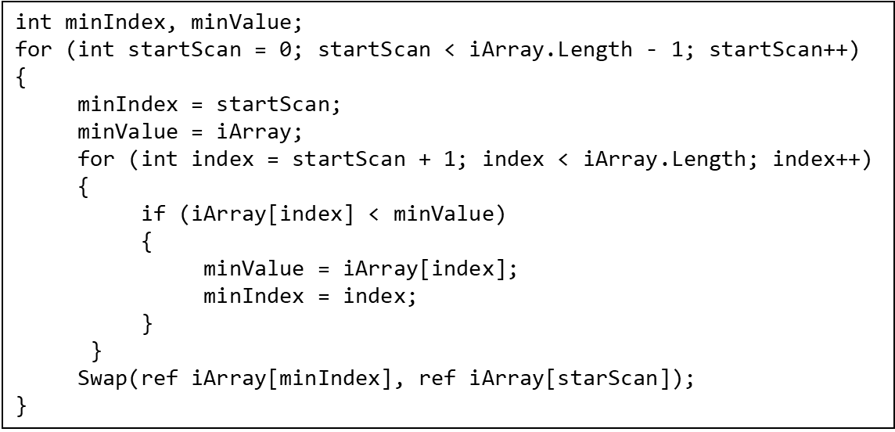
Advanced Algorithms for Sorting and Searching (3 of 3)
The selection sort algorithm:

Slide 37
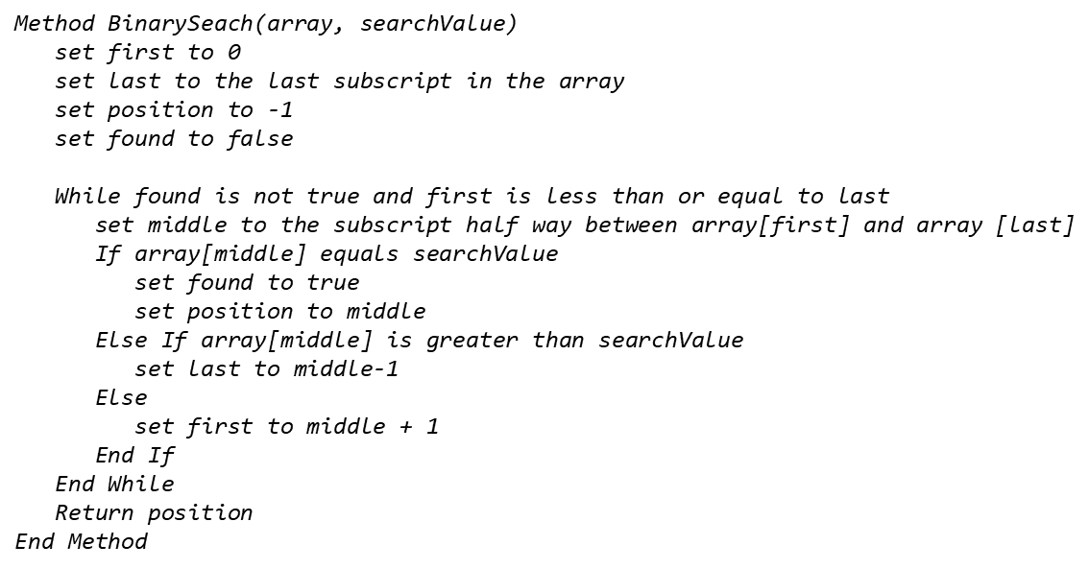
The Binary Search Algorithm
The binary search is a clever algorithm that is normally more efficient than the sequential search. Here is the pseudocode for a method that performs a binary search on an array:

Slide 38
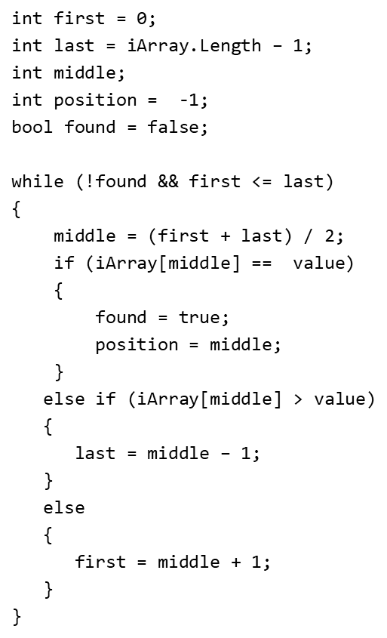
Sample Code

Slide 39
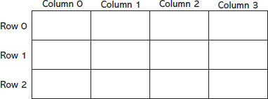
Two-Dimensional Arrays
A two-dimensional (2D) array is like several arrays put together
Can hold (store) multiple sets of data
Can be illustrated by a table with rows and columns
Row - horizontal
Column – vertical
Rows and columns are numbered 0, 1, 2, etc.

Slide 40
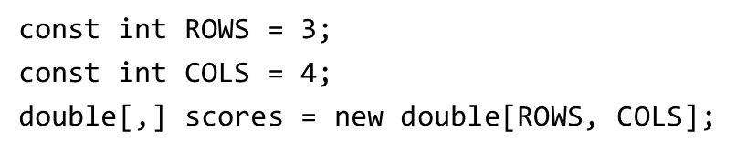
Declaring a 2D Array (1 of 2)
A 2D array requires two size declarators
The first for rows, the second for columns
This declares that the scores variable references a 2D array
3 defines the size of the rows and 4 defines the size of the columns
Size declarators are separated by a comma

Slide 41
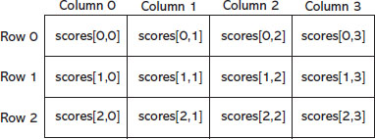
Declaring a 2D Array (2 of 2)

Slide 42
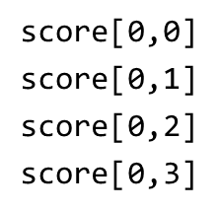
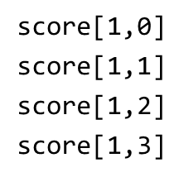
Accessing Elements in a 2D Array (1 of 2)
Each element in a 2D array has two subscripts
One for its rows and one for its columns:
Elements in row 0 are:
Elements in row 1 are:

Slide 43
Accessing Elements in a 2D Array (2 of 2)

Slide 44
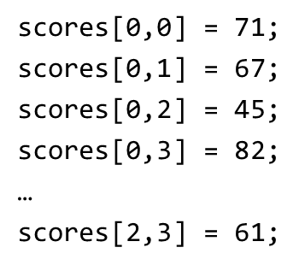
Assigning Values to Elements (1 of 2)
To assign values to the elements, use:
Blank | Column 0 | Column 1 | Column 2 | Column 3
Row 0 | 71 | 67 | 45 | 82
Row 1 | 54 | 87 | 90 | 68
Row 2 | 80 | 75 | 39 | 61

Slide 45
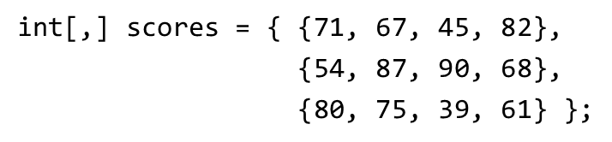
Assigning Values to Elements (2 of 2)
To implicitly assign the size and initialization of a 2D array, use:

Slide 46
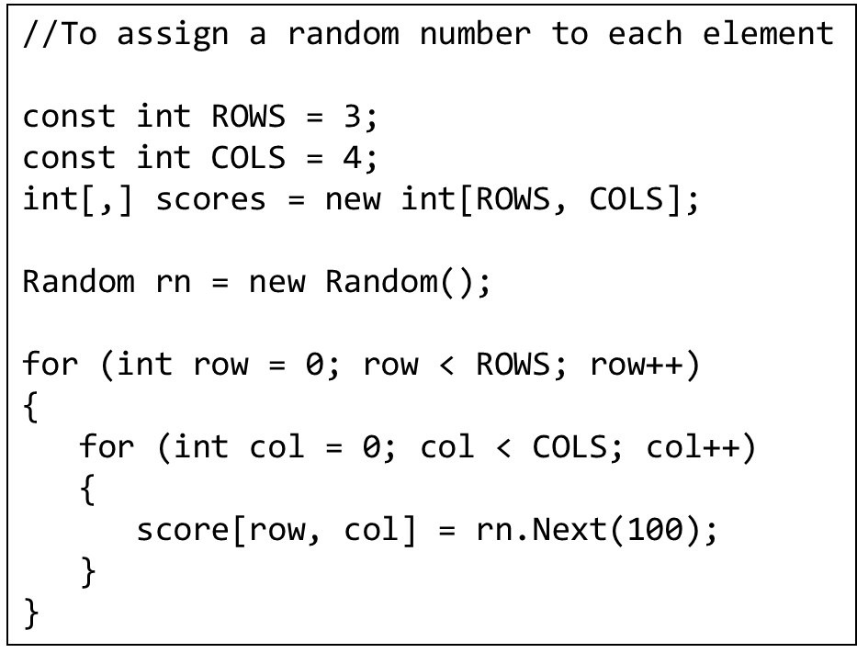
Use Nested Loops to Process 2D Arrays (1 of 2)

Slide 47
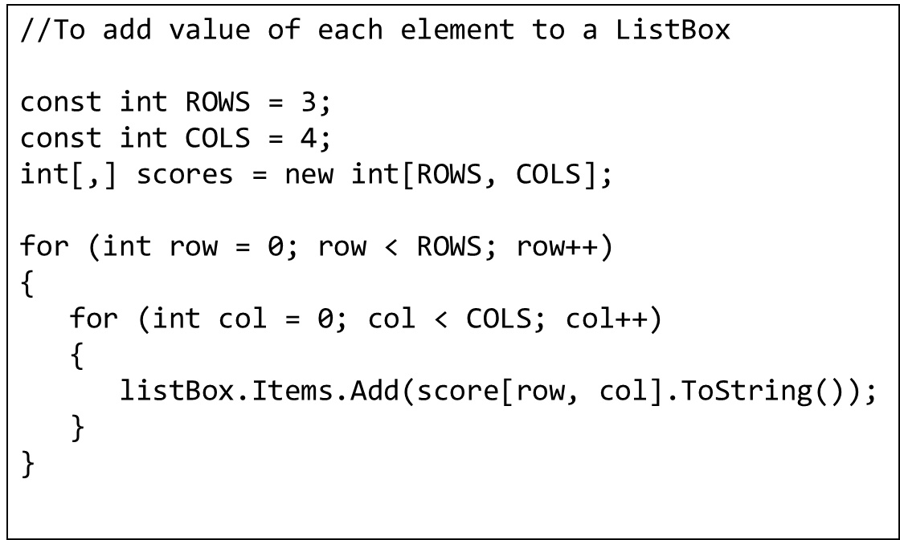
Use Nested Loops to Process 2D Arrays (2 of 2)

Slide 48
Getting the Length of a Two-Dimensional Array
The Length property of a two-dimensional array returns the total number of elements in the array.
Example:
int[,] values = { {1, 2, 3},
{4, 5, 6},
{7, 8, 9} };
MessageBox.Show("The array has " + values.Length +
" elements.");
This code will display The array has 9 elements.

Slide 49
Getting the Number of Dimensions (1 of 2)
You can determine the number of rows and columns in an array with the GetLength method.
You pass 0 as an argument to get the number of rows, or 1 to get the number of columns.
Example:
int[,] values = { {1, 2, 3},
{4, 5, 6} };
MessageBox.Show("The array has " + values.GetLength(0) +
" rows and " + values.GetLength(1) +
" columns.");
This code will display The array has 2 rows and 3 columns.

Slide 50
Getting the Number of Dimensions (2 of 2)
The GetLength method is useful in loops that step through the elements of a two-dimensional array.
Example:
int[,] values = { {1, 2, 3},
{4, 5, 6} };
for (int row = 0; row < values.GetLength(0); row++)
{
for (int col = 0; col < values.GetLength(1); col++)
{
outputListBox.Items.Add(values[row, col].ToString());
}
}

Slide 51
Passing a Two-Dimensional Array to a Method
If a method is to receive a two-dimensional array as an argument, its parameter must be declared accordingly.
For example, the following method receives a two-dimensional string array as its argument:
private void DisplayArray(string[,] array)
{
for (int row = 0; row < array.GetLength(0); row++)
{
for (int col = 0; col < array.GetLength(1); col++)
{
outputListBox.Items.Add(array[row, col]);
}
}
}

Slide 52
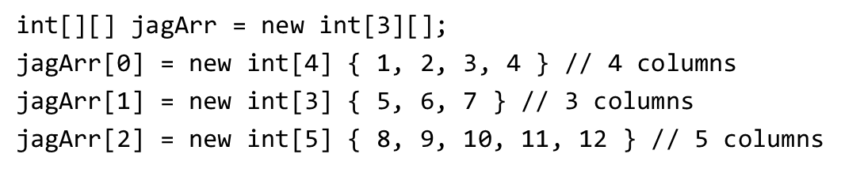
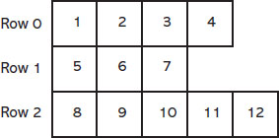
Jagged Arrays (1 of 2)
A jagged array is special type of 2D array
rows in a jagged array can have different lengths

Slide 53

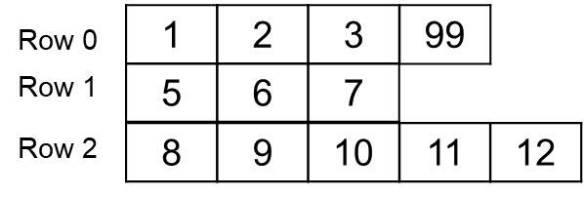
Jagged Arrays (2 of 2)
To access an element, use:
To assign a value to row 0, column 3, use:

Slide 54
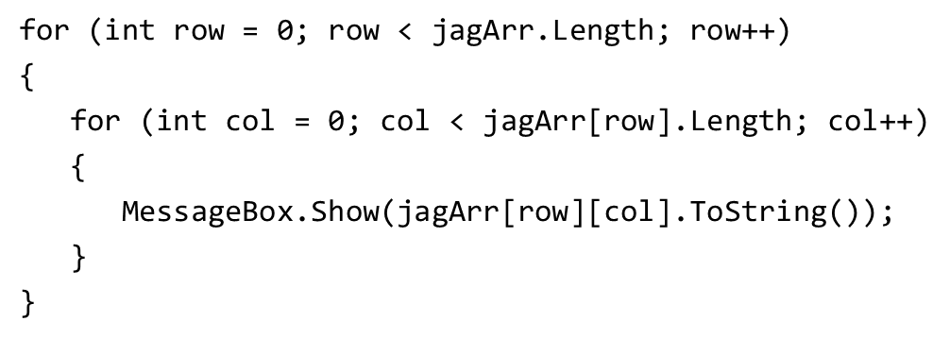
Use Nested Loops to Process Jagged Arrays
Jagged arrays have a Length property
Holds the number of rows
Each row also has a Length property
Holds the number of columns
The following nested loops display all the values of a jagged array:

Slide 55
The List Collection
The C# List is a class in .NET that is similar to an array with the following advantages:
A List object does not require a size declaration
Its size is automatically adjusted
You can add or remove items
Syntax to create a List is:
For example,

Slide 56
Using var to Declare a List
If you are declaring a List inside a method, you can use the var keyword to further simplify the declaration:
var numberList = new List<int>();

Slide 57
Initializing a List
You can optionally initialize a List when you declare it.
Examples:
List<int> numberList = new List<int>() { 1, 2, 3 };
var myNumbers = new List<int>() { 10, 20, 30 };
var nameList = new List<string>() { "Kris",
"Nina", "Ravi" };

Slide 58
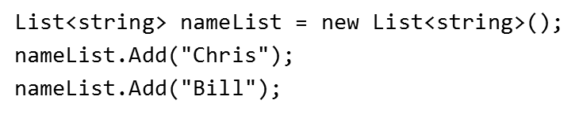

Add or Remove Items From a List (1 of 2)
To add items, use the Add method
To insert an item, use the Insert method to insert an item at a specific index

Slide 59
Add or Remove Items From a List (2 of 2)
To remove items, use:
Remove method: remove an item by its value nameList.Remove("Bill");
RemoveAt method: remove an item at a specific index nameList.RemoveAt(0);

Slide 60
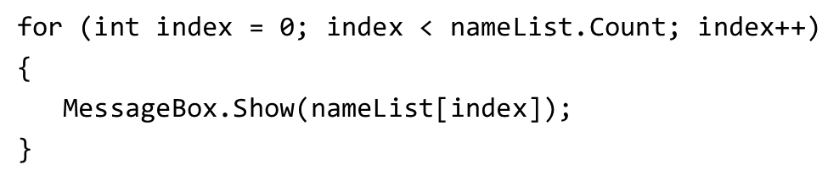
Initializing a List Implicitly
To initialize a List implicitly, simply define its items when you declare it
var numberList = new List<int>() { 1, 2, 3 };
var nameList = new List<string>() { "Kris", "Nina", "Ravi" };
The Count property holds the number of items stored in the List
Useful in accessing all items in a List

